Slide 1
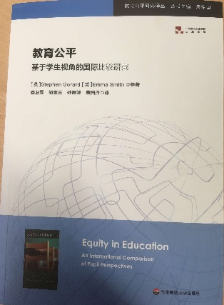







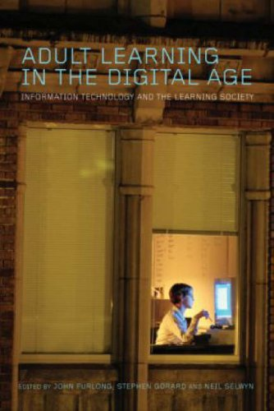

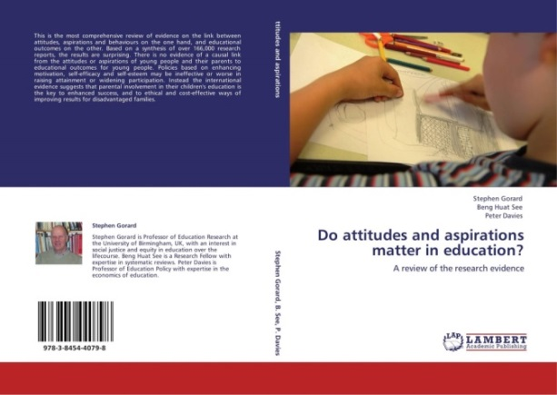











Let’s make education fairer: Disadvantage, school intakes and outcomes
Stephen Gorard, s.a.c.gorard@durham.ac.uk
Director of DECE
Durham University
https://www.dur.ac.uk/dece/
Follow me on Twitter
@SGorard

Slide 2
Comparison of KS4 points, means for pupils missing data in Year 10
Category | Yes | No | “Effect” size
FSM missing | 199.10 | 312.23 | -1.16
SEN missing | 199.10 | 312.23 | -1.16
Language missing | 228.12 | 312.15 | -0.86
Ethnic group missing | 270.31 | 312.20 | -0.43
Overall standard deviation=97.77

Slide 3
SEN reporting by age-in-year, England, 2015 KS4 cohort

Slide 4
Attainment by number of years-FSM, England, 2015 KS4 cohort

Slide 5
Home LAs of FSM-eligible pupils – mean number of years eligible, 2015 cohort
Local Authority | Years FSM by KS2 | Years FSM by KS4
Wokingham | 0.3 | 0.5
Buckinghamshire | 0.3 | 0.6
West Sussex | 0.4 | 0.7
Middlesbrough | 1.9 | 3.1
Manchester | 2.1 | 3.4

Slide 6
Percentage of pupils with specified characteristics by number of years-FSM, England 2015

Slide 7
Estimate of variation in KS4 outcomes explained by each step of the model
Year | R | Increase in R | Variables
1 (primary school start) | 0.546 | - | 2005 background, missing values
 | 0.576 | 0.030 | 2005 school mean background
2 (KS1 end) | 0.578 | 0.002 | 2006 background, missing values
 | 0.579 | 0.001 | 2006 school mean background
2 (KS1 attainment) | 0.684 | 0.106 | KS1 scores for pupil
 | 0.685 | 0.001 | KS1 scores school, interaction
3 (KS2 start) | 0.692 | 0.007 | 2007 background, missing values
 | 0.693 | 0.001 | 2007 school mean background
4 | 0.701 | 0.008 | 2008 background, missing values
 | 0.701 | - | 2008 school mean background
5 | 0.708 | 0.007 | 2009 background, missing values
 | 0.709 | 0.001 | 2009 school mean background
6 (KS2 end) | 0.717 | 0.008 | 2010 background, missing values
 | 0.718 | 0.001 | 2010 school mean background
6 (KS2 attainment) | 0.820 | 0.102 | KS2 scores for pupil
 | 0.821 | 0.001 | KS2 scores school, interaction
7 (secondary school start) | 0.826 | 0.005 | 2011 background, missing values
 | 0.827 | 0.001 | 2011 school mean background
8 | 0.829 | 0.002 | 2012 background, missing values
 | 0.829 | - | 2012 school mean background
9 (KS3 end) | 0.833 | 0.004 | 2013 background, missing values
 | 0.834 | 0.001 | 2013 school mean background
9 (KS3 attainment) | 0.883 | 0.049 | KS3 scores for pupil
 | 0.885 | 0.002 | KS3 scores school, interaction
10 (KS4 start) | 0.888 | 0.003 | 2014 background, missing values
 | 0.888 | - | 2014 school mean background
11 (KS4 end) | 0.899 | 0.029 | 2015 background, missing values, summary
 | 0.900 | 0.001 | 2015 school mean background, summary
11 (KS4 type of school) | 0.900 | 0.000 | Region and type of school

Slide 8
Standardised regression coefficients, Years 1 to 6 at school
Variable | Year 1 | Year 2, KS1 end | Year 3 | Year 4 | Year 5 | Year 6, KS2 end
Individual predictors
Sex of pupil | 0.080 | - | - | - | - | -
Age in year | -0.012 | - | - | - | - | -
FSM eligible | -0.217 | -0.083 | -0.053 | -0.053 | -0.051 | -0.054
FSM missing | -0.035 | - | - | - | - | -
SEN statement | -0.282 | - | -0.127 | -0.143 | -0.148 | -0.154
SEN no statement | -0.321 | - | -0.116 | -0.131 | -0.138 | -0.148
SEN missing | -0.073 | - | -0.070 | -0.046 | -0.056 | -0.085
English not first language | 0.075 | 0.034 | 0.064 | 0.033 | 0.016 | -0.021
Language missing | 0.026 | 0.003 | 0.021 | 0.001 | 0.020 | 0.030
Ethnic group Black | 0.024 | - | 0.016 | 0.009 | 0.012 | 0.007
Ethnic group Asian | 0.014 | - | 0.029 | 0.032 | 0.028 | 0.026
Ethnic group Chinese | 0.025 | - | 0.019 | 0.020 | 0.019 | 0.021
Ethnic group other | 0.027 | - | 0.019 | 0.017 | 0.021 | 0.019
Ethnic group missing | - | - | 0.016 | 0.017 | 0.005 | 0.018
Travelled to another authority | - | -0.010 | -0.005 | -0.005 | -0.006 | -0.007
School and area predictors
IDACI score | -0.132 | -0.072 | -0.044 | -0.040 | -0.030 | -0.021
Number of pupils in school | -0.005 | 0.021 | 0.004 | 0.011 | -0.028 | -0.008
FSM level in school | - | -0.023 | - | -0.021 | - | -
FSM segregation, school | -0.052 | - | -0.022 | - | -0.039 | -0.019
SEN statement level, school | -0.087 | - | -0.040 | -0.025 | -0.046 | -0.030
SEN no statement level, school | 0.008 | - | -0.010 | -0.015 | -0.019 | -0.012
End of KS
School mean years FSM | - | - | - | - | - | -0.051
Individual points score | - | 0.408 | - | - | - | 0.574
School mean of points score | - | -0.037 | - | - | - | -0.040

Slide 9
Standardised regression coefficients for KS4 Region and school type
Variable |  | Standardised coefficient
School in NE England or not |  | 0.003
School in area with grammar schools |  | 0.001
Community school or not |  | -0.004
Comprehensive school or not |  | -0.002
Grammar school or not |  | -0.020
Academy converter or not |  | -
Free school, Studio or UTC |  | 0.003
Voluntary-aided (faith) or not |  | -
Voluntary controlled (faith) or not |  | 0.001
Special school or not |  | 0.026

Slide 10
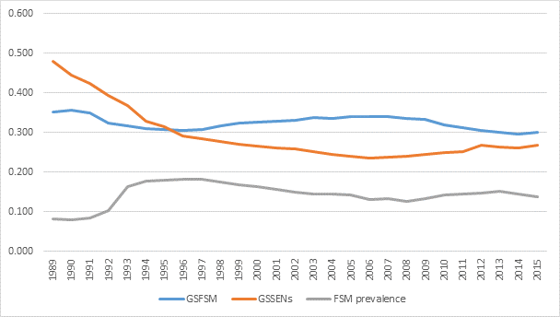
Segregation between schools by FSM eligibility and SEND statements, England 1989 to 2015
GSFSM: Clustering by FSM. GSSENs: Clustering by statements of SEND. FSM prevalence: proportion of all pupils FSM-eligible.

Slide 11
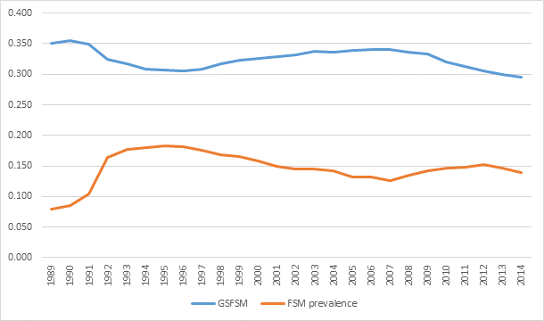
Segregation between schools by FSM eligibility and FSM prevalence, England 1989 to 2015
GSFSM: Clustering by FSM. FSM prevalence: proportion of all pupils FSM-eligible.

Slide 12
This work was funded by the ESRC (grant number ES/N012046/1).
Selected references
Gorard, S. (2018) Education policy: Evidence of equity and effectiveness, Bristol: Policy Press
Gorard, S. and Siddiqui, N. (2018) Grammar schools in England: a new analysis of social segregation and academic outcomes, British Journal of Sociology of Education, 39, 7, 909-924
Gorard, S., Boliver, V., Siddiqui, N. and Banerjee, P. (2017) Which are the most suitable contextual indicators for use in widening participation to HE?, Research Papers in Education,http://www.tandfonline.com/doi/pdf/10.1080/02671522.2017.1402083?needAccess=true
Gorard, S., Siddiqui, N. and Boliver, V. (2017) An analysis of school-based contextual indicators for possible use in widening participation, Higher Education Studies, 7, 2, 101-118
Siddiqui, N. and Gorard, S. (2017) Comparing government and private schools in Pakistan: the way forward for universal education, International Journal of Educational Research, 82, 159-169
Gorard, S., See, BH and Siddiqui, N. (2017) What works and what fails? Evidence from seven popular literacy catch-up schemes for the transition to secondary school in England, Research Papers in Education, 32, 5
Siddiqui, S., Gorard, S. and See, BH (2017) Can programmes like Philosophy for Children help schools to look beyond academic attainment?, Educational Review, http://dx.doi.org/10.1080/00131911.2017.1400948
See, BH, Gorard, S. and Siddiqui, N. (2017) Does participation in uniformed group activities in school improve young p eople’s non-cognitive outcomes?, International Journal of Educational Research, 85, 109-120
Gorard, S., Siddiqui, N. and See, BH (2017) Can ‘Philosophy for Children’ improve primary school attainment, Journal of Philosophy of Education, http://onlinelibrary.wiley.com/doi/10.1111/1467-9752.12227/abstract
See, BH, Gorard, S. and Siddiqui, N. (2017) Can explicit teaching of knowledge improve reading attainment?: An evaluation of the core knowledge curriculum, British Educational Research Journal, 43, 2, 372–393
Gorard, S., See, BH and Siddiqui, N. (2017) What works and what fails? Evidence from seven popular literacy catch-up schemes for the transition to secondary school in England, Research Papers in Education, 32, 5
Gorard, S., Siddiqui, N. and See, BH (2016) An evaluation of Fresh Start as a catch-up intervention: And whether teachers can conduct trials, Educational Studies, 42, 1, 98-113, DOI: 10.1080/03055698.2016.1148587
Gorard, S. (2015) Helping August’s child, New Scientist, 17 October 2015, pp.8-9
Gorard, S. (2015) The uncertain future of comprehensive schooling in England, European Educational Research Journal, 14, 3-4, 257-268, http://eer.sagepub.com/cgi/reprint/14/3-4/257.pdf?ijkey=6QSxgjXEXzExZC2&keytype=finite

